Slide 1
Statistical Analysis of Machine Learning Algorithms for Fraud Detection in Bank Transactions
Siddharth Jain – 1226137070
Ketan Chaudhary – 1226082301
Pranav Chougule – 1225934595

Slide 2
Abstract
We compared the performance of five popular machine learning algorithms for detecting fraud in bank transactions.
Preprocessing technique one-hot encoding – was explored to determine its impact on model performance.
Feature importance was used to train models only on the most important features, reducing complexity and improving performance.
Statistical tests (Wilcoxon signed-rank test and Friedman chi-squared test) confirmed significant performance differences between the models.

Slide 3
Introduction
Online banking and e-commerce have increased the risk of fraudulent transactions, making fraud detection systems crucial for the financial industry.
Machine learning algorithms can analyze large amounts of data and detect patterns and anomalies to detect fraudulent transactions effectively.
Five popular machine learning algorithms were compared in this project: recurrent neural network (LSTM), neural network, logistic regression, random forest, and gradient boosting.
Preprocessing technique was explored to determine the impact on model performance: one-hot encoding, and feature importance was performed to reduce model complexity.
SMOTE technique was performed to address the imbalanced and skewed dataset.
Evaluation metrics such as F1 score, recall, precision, ROC curve, and accuracy were used to determine the performance of the models for detecting fraud in bank transactions.

Slide 4
Introduction
Non-parametric tests such as Wilcoxon signed-rank and Friedman's chi-squared tests were conducted to validate the observed performance differences between the models.
The study provides insights into the effectiveness of machine learning algorithms, preprocessing techniques, and feature importance for fraud detection in bank transactions.
By improving the accuracy and efficiency of fraud detection systems, financial institutions can better protect themselves and their customers from fraudulent activities.
Non-parametric tests provide a robust evaluation of the performance of the machine learning models for detecting fraud in bank transactions.
The results of this project can help financial institutions develop more effective fraud detection systems to prevent financial losses.

Slide 5
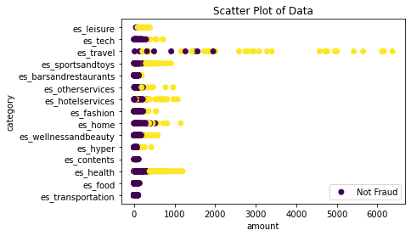
Dataset
The dataset used in the project contains 594,643 rows and 10 columns in a CSV file format.
The data in the dataset represents bank transactions, with each row corresponding to a single transaction.
The columns in the dataset include step, customer, age, gender, zipcodeOri, merchant, zipMerchant, category, amount, and a target column fraud.
The dataset was obtained from Kaggle.com using the provided link.
There are 7200 fraudulent transactions in the dataset.
There are 587443 non fraudulent transactions in the dataset.
Ratio of fraudulent to non fraudulent transactions is 0.012256508291017171

Slide 6
Algorithms
RNN – LSTM
NN
Logistic Regression
Random Forest
Gradient Boosting

Slide 7
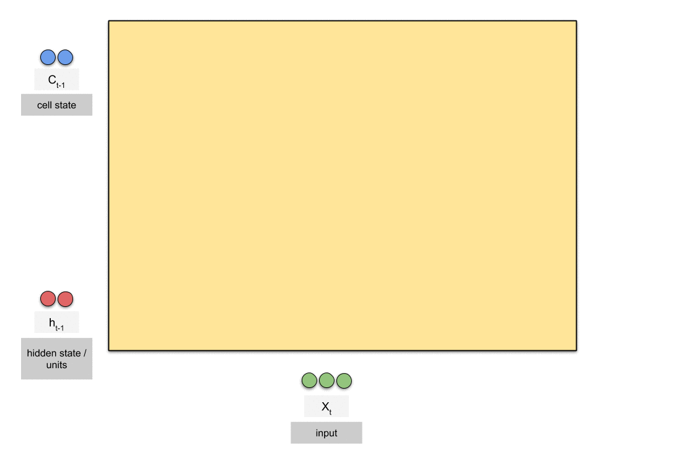
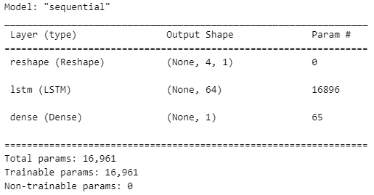
Recurrent Neural Networks - LSTM
RNNs with LSTMs are well-suited for analyzing sequential data such as transaction histories or user behavior patterns to identify patterns and trends that may indicate fraudulent activity.
The model can be trained on past transaction data to predict whether new transactions are likely to be fraudulent or not.
LSTMs (Long Short-Term Memory) are a type of RNN that are specifically designed to address the problem of vanishing gradients, which can occur in traditional RNNs and limit their ability to learn long-term dependencies in the data.
LSTMs achieve this by introducing additional gates into the network architecture that allow the model to selectively store or forget information over time.

Slide 8
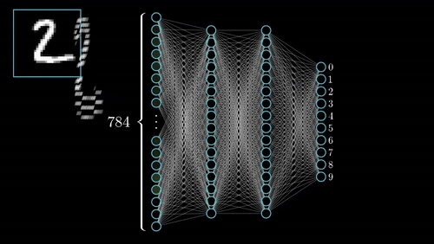
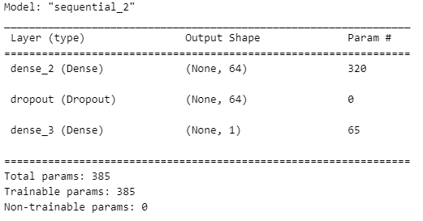
Neural Networks
Neural networks can be trained to classify bank transactions as fraudulent or not based on input features such as transaction amount, merchant, category, and customer information.
The network can be optimized to minimize the difference between the predicted and actual target values, resulting in a model that can effectively identify fraudulent transactions.

Slide 9
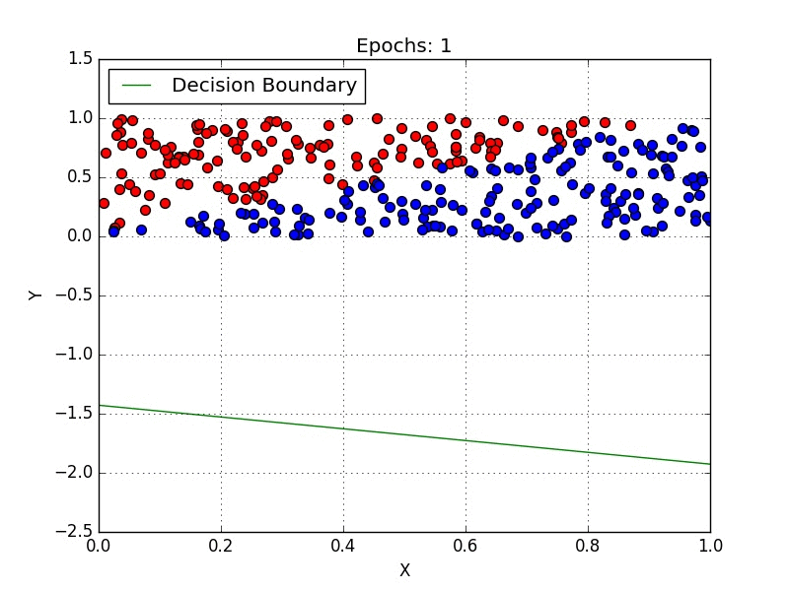
Logistic Regression
Logistic regression is a linear model that can be used to predict the probability of a transaction being fraudulent based on input features.
The model can output a probability score, which can be used to filter and rank predictions based on confidence.
Logistic Regression can handle both categorical and continuous input features.
Logistic Regression can suffer from overfitting if the number of input variables is too large relative to the number of training samples.

Slide 10
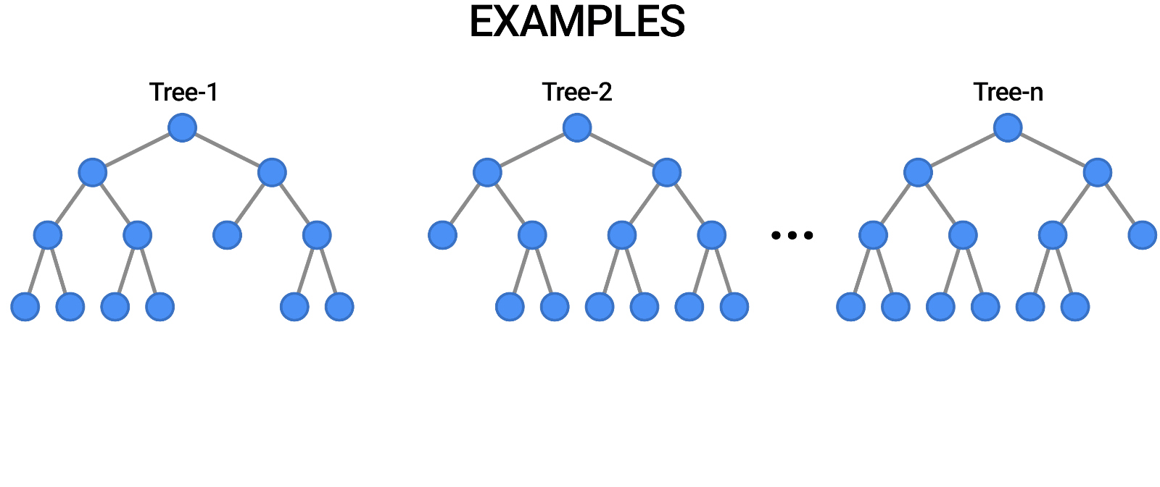
Random Forest
Random Forest is a decision tree-based algorithm that can be used to identify patterns in the data that may indicate fraudulent activity.
The algorithm can handle missing data and non-linear relationships between input and target variables, making it suitable for use with bank transaction data.

Slide 11
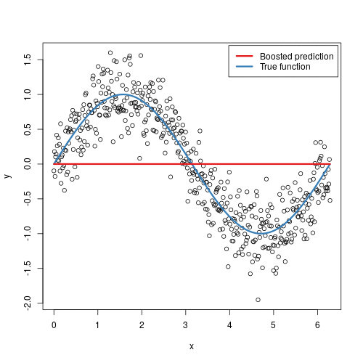
Gradient Boosting
Gradient Boosting is an ensemble learning algorithm that builds multiple decision trees sequentially, where each tree corrects the errors of the previous tree.
The algorithm is well-suited for handling complex data with non-linear relationships between input and target variables, and it provides feature importance scores for interpretation.
This can be helpful in identifying which input features are most important in predicting whether a transaction is fraudulent or not.

Slide 12
Methods
Preprocessing
Feature Importance
Hyperparameter Tuning
Evaluation
Statistical Tests

Slide 13
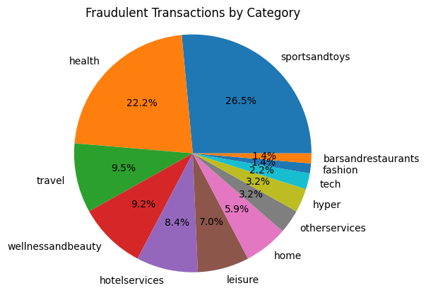
Preprocessing
To make the processing faster, the dataset has been reduced to 30000 entries.
Fraudulent transactions:
There are 370 fraudulent transactions in the dataset.
There are 29630 non fraudulent transactions in the dataset.
Ratio of fraudulent to non fraudulent transactions is 0.01248
Due to the high imbalance and skewed nature of the dataset, SMOTE technique has been applied to synthesize fraudulent transactions.
Fraudulent transactions:
There are 29647 fraudulent transactions in the dataset.
There are 29647 non fraudulent transactions in the dataset.
Ratio of fraudulent to non fraudulent transactions is 1

Slide 14
One-Hot Encoding
One-hot encoding converts categorical variables into a set of binary variables, creating a new binary column for each unique category in the original data.
For each observation, a 1 is assigned to the appropriate column and 0 to all other columns, preserving the information in the original data.
One-hot encoding is more flexible than label encoding and does not introduce any unintended mathematical relationships.
For instance, we used one-hot encoding to convert the merchant column into binary variables for each unique merchant in the dataset. This enabled our machine learning models to learn the relationships between merchants and fraudulent activities more effectively.

Slide 15
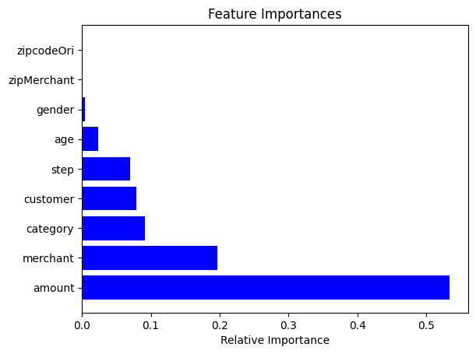
Feature Importance
Feature importance is a technique used in machine learning to identify the most important features in a dataset, which can help simplify the model and reduce the risk of overfitting.
This technique involves using algorithms like random forest to rank the features based on their importance in predicting the target variable.
In the project involving fraud detection in bank transactions, certain features like Zip Code Origin, Zip Code Merchant, Gender, Age and Step were discarded as they were found to be less important in predicting fraudulent activities.
This helped to streamline the training process of the model and improve its efficiency. By only using the most important features, the model was simplified and became more robust and easier to interpret.

Slide 16
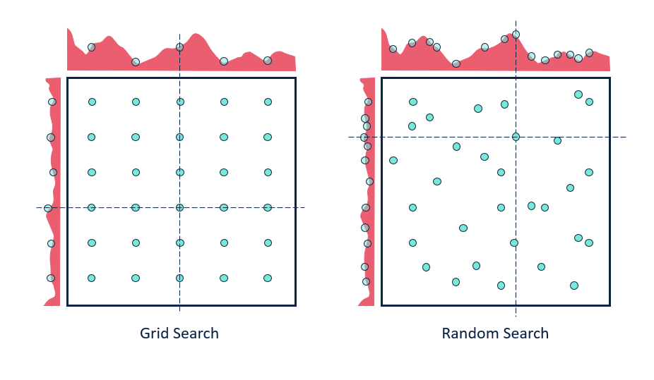
Hyperparameter Tuning
Hyperparameter tuning is a crucial step in improving the performance of machine learning models.
In our project, we have used techniques like grid search to find the optimal combination of hyperparameters such as the learning rate, regularization strength, and number of estimators in our model.
This helps to ensure that the model is properly optimized for the given task and can perform at its best.
By exhaustively searching through the grid of hyperparameter values and evaluating the model's performance through cross-validation, we can find the best combination of hyperparameters that improve the accuracy of our model.

Slide 17
RESULTS

Slide 18
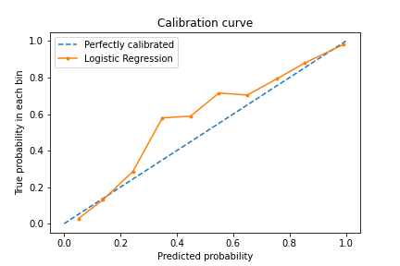
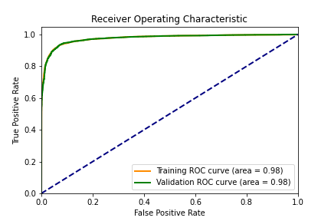
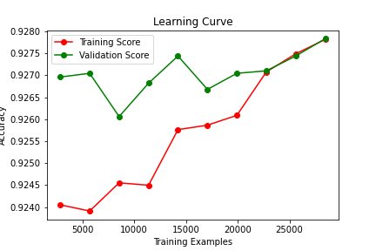
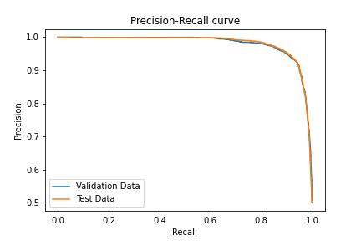
Logistic Regression

Slide 19
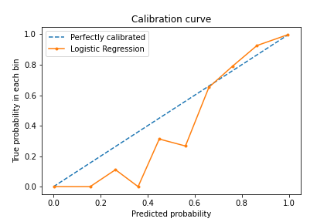
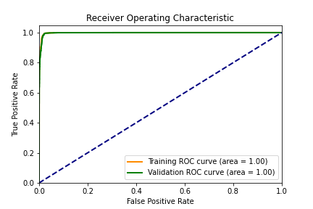
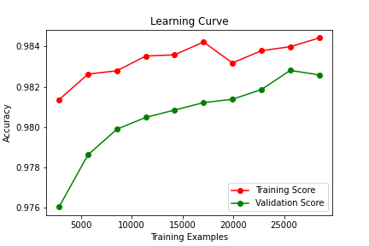
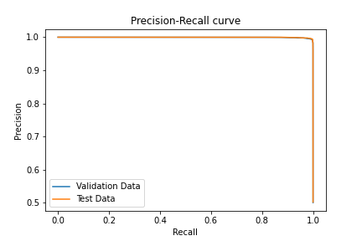
Random Forest

Slide 20
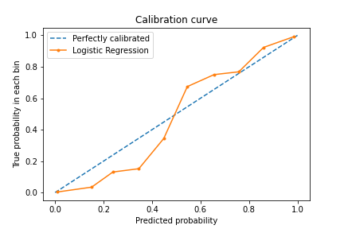
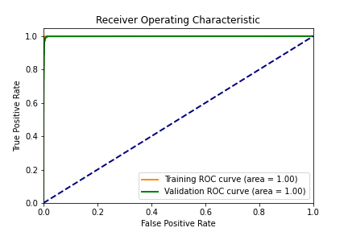
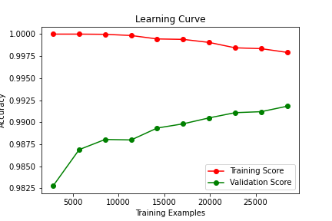
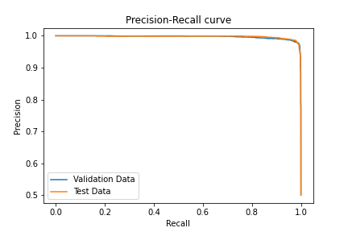
Gradient Boosting

Slide 21
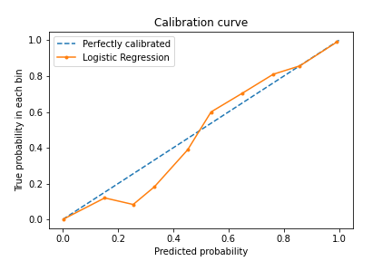
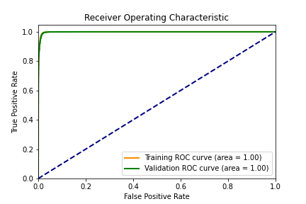
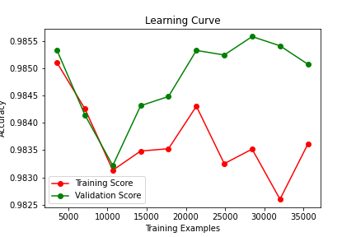

RNN - LSTM

Slide 22
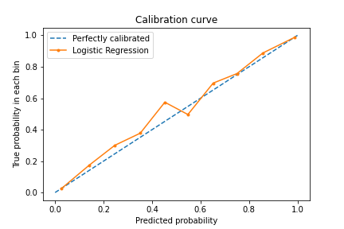
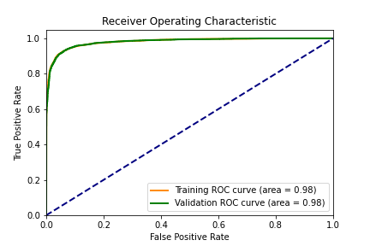
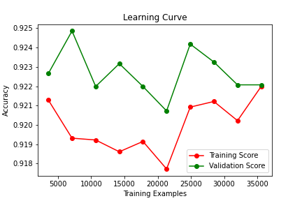
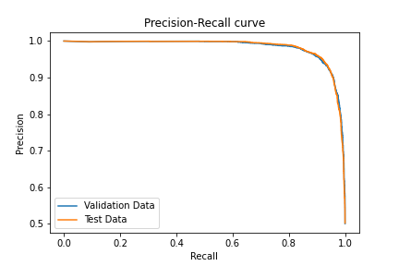
Neural Network
Label Encoding
One-Hot Encoding

Slide 23
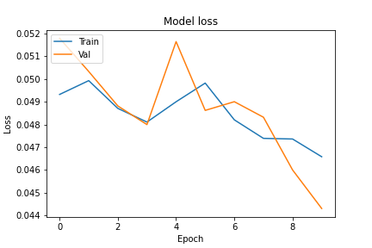
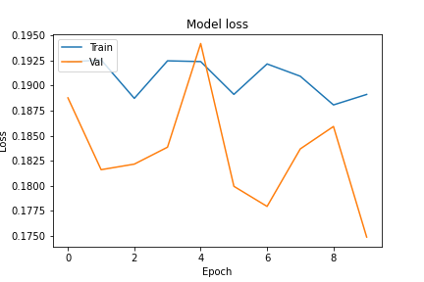
LSTM vs Neural Network

Slide 24
Metric Analysis
Model/Metric | Accuracy | Precision | Recall | F1 | ROC
Logistic Regression | 0.931 | 0.968 | 0.922 | 0.942 | 0.935
Gradient Boosting | 0.967 | 0.9787 | 0.980 | 0.976 | 0.985
Random Forest | 0.933 | 0.956 | 0.964 | 0.967 | 0.956
RNN | 0.973 | 0.985 | 0.982 | 0.986 | 0.987
NN | 0.953 | 0.954 | 0.937 | 0.945 | 0.943
Binary classification tasks are evaluated using metrics such as accuracies, precision, recall, F1-score, and ROC-AUC scores.
2. The logistic regression model has relatively high precision but lower recall, suggesting that it may be more conservative in predicting fraud cases, potentially leading to missed fraudulent transactions.
3. The gradient boosting classifier model has the highest ROC AUC score, indicating that it has the best overall performance in distinguishing between fraudulent and non-fraudulent transactions.
4. The random forest model has relatively lower accuracy compared to other models, indicating that it may misclassify some fraudulent and non-fraudulent transactions.
5. The RNN model has the highest precision, recall, accuracy, F1 score, and ROC AUC score among all models, indicating that it performs best in detecting fraudulent transactions.
6. The NN model has relatively lower precision and recall compared to other models, indicating that it may have more false positives and false negatives, potentially leading to higher financial losses for the bank.

Slide 25
Statistical Analysis of Accuracies
Looking at the given results, we can see that the mean accuracy of the five algorithms is very high, with an average accuracy of 0.9541. This indicates that the algorithms are performing very well on the given task.
The standard deviation of 0.0171 is also relatively small, which suggests that the accuracies obtained from the five algorithms are clustered around the mean accuracy and do not vary too much from one another.
The T-statistic of 52.7026 is very high, indicating that the difference between the mean accuracy of the five algorithms and the expected accuracy of 0.5 is significant. This means that the algorithms are performing significantly better than random guessing.
Finally, the P-value of 0.0000 is very low, which indicates that the probability of obtaining a T-statistic as extreme as the one observed if the null hypothesis is true is very low. This provides strong evidence against the null hypothesis and supports the conclusion that the algorithms are performing significantly better than random guessing.
In summary, the statistical analysis suggests that the five algorithms are performing very well on the given task, with a mean accuracy of 0.9541 and a very low P-value, indicating that their performance is significantly better than random guessing.

Slide 26
Freidman Chi-Square Test
We ran five different algorithms and evaluated their performance using multiple metrics, including test accuracy, precision, recall, F1 score, and ROC AUC.
The Friedman test was used to compare the mean ranks of the algorithms across all the metrics. The test statistic was 12.0000 and the p-value was 0.0174.
Since the p-value is less than the significance level of 0.05, we reject the null hypothesis that the algorithms perform similarly and conclude that there is a significant difference between them.
While the Friedman test does not tell us which algorithm is better or worse than the others, further analysis, such as post-hoc tests or pairwise comparisons, can be used to determine which algorithms have significantly different ranks.

Slide 27
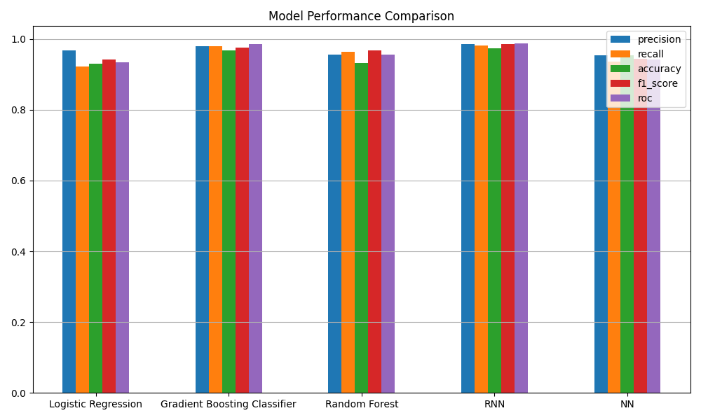
Best Model

Slide 28
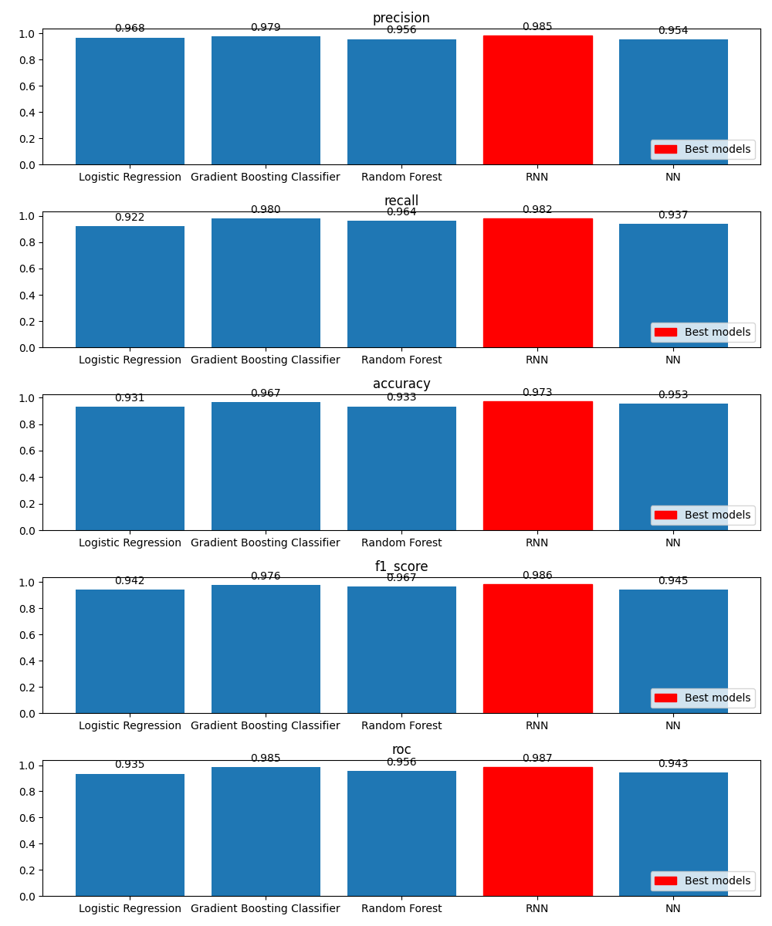
Best Model

Slide 29
THANK YOU

